Slide 1
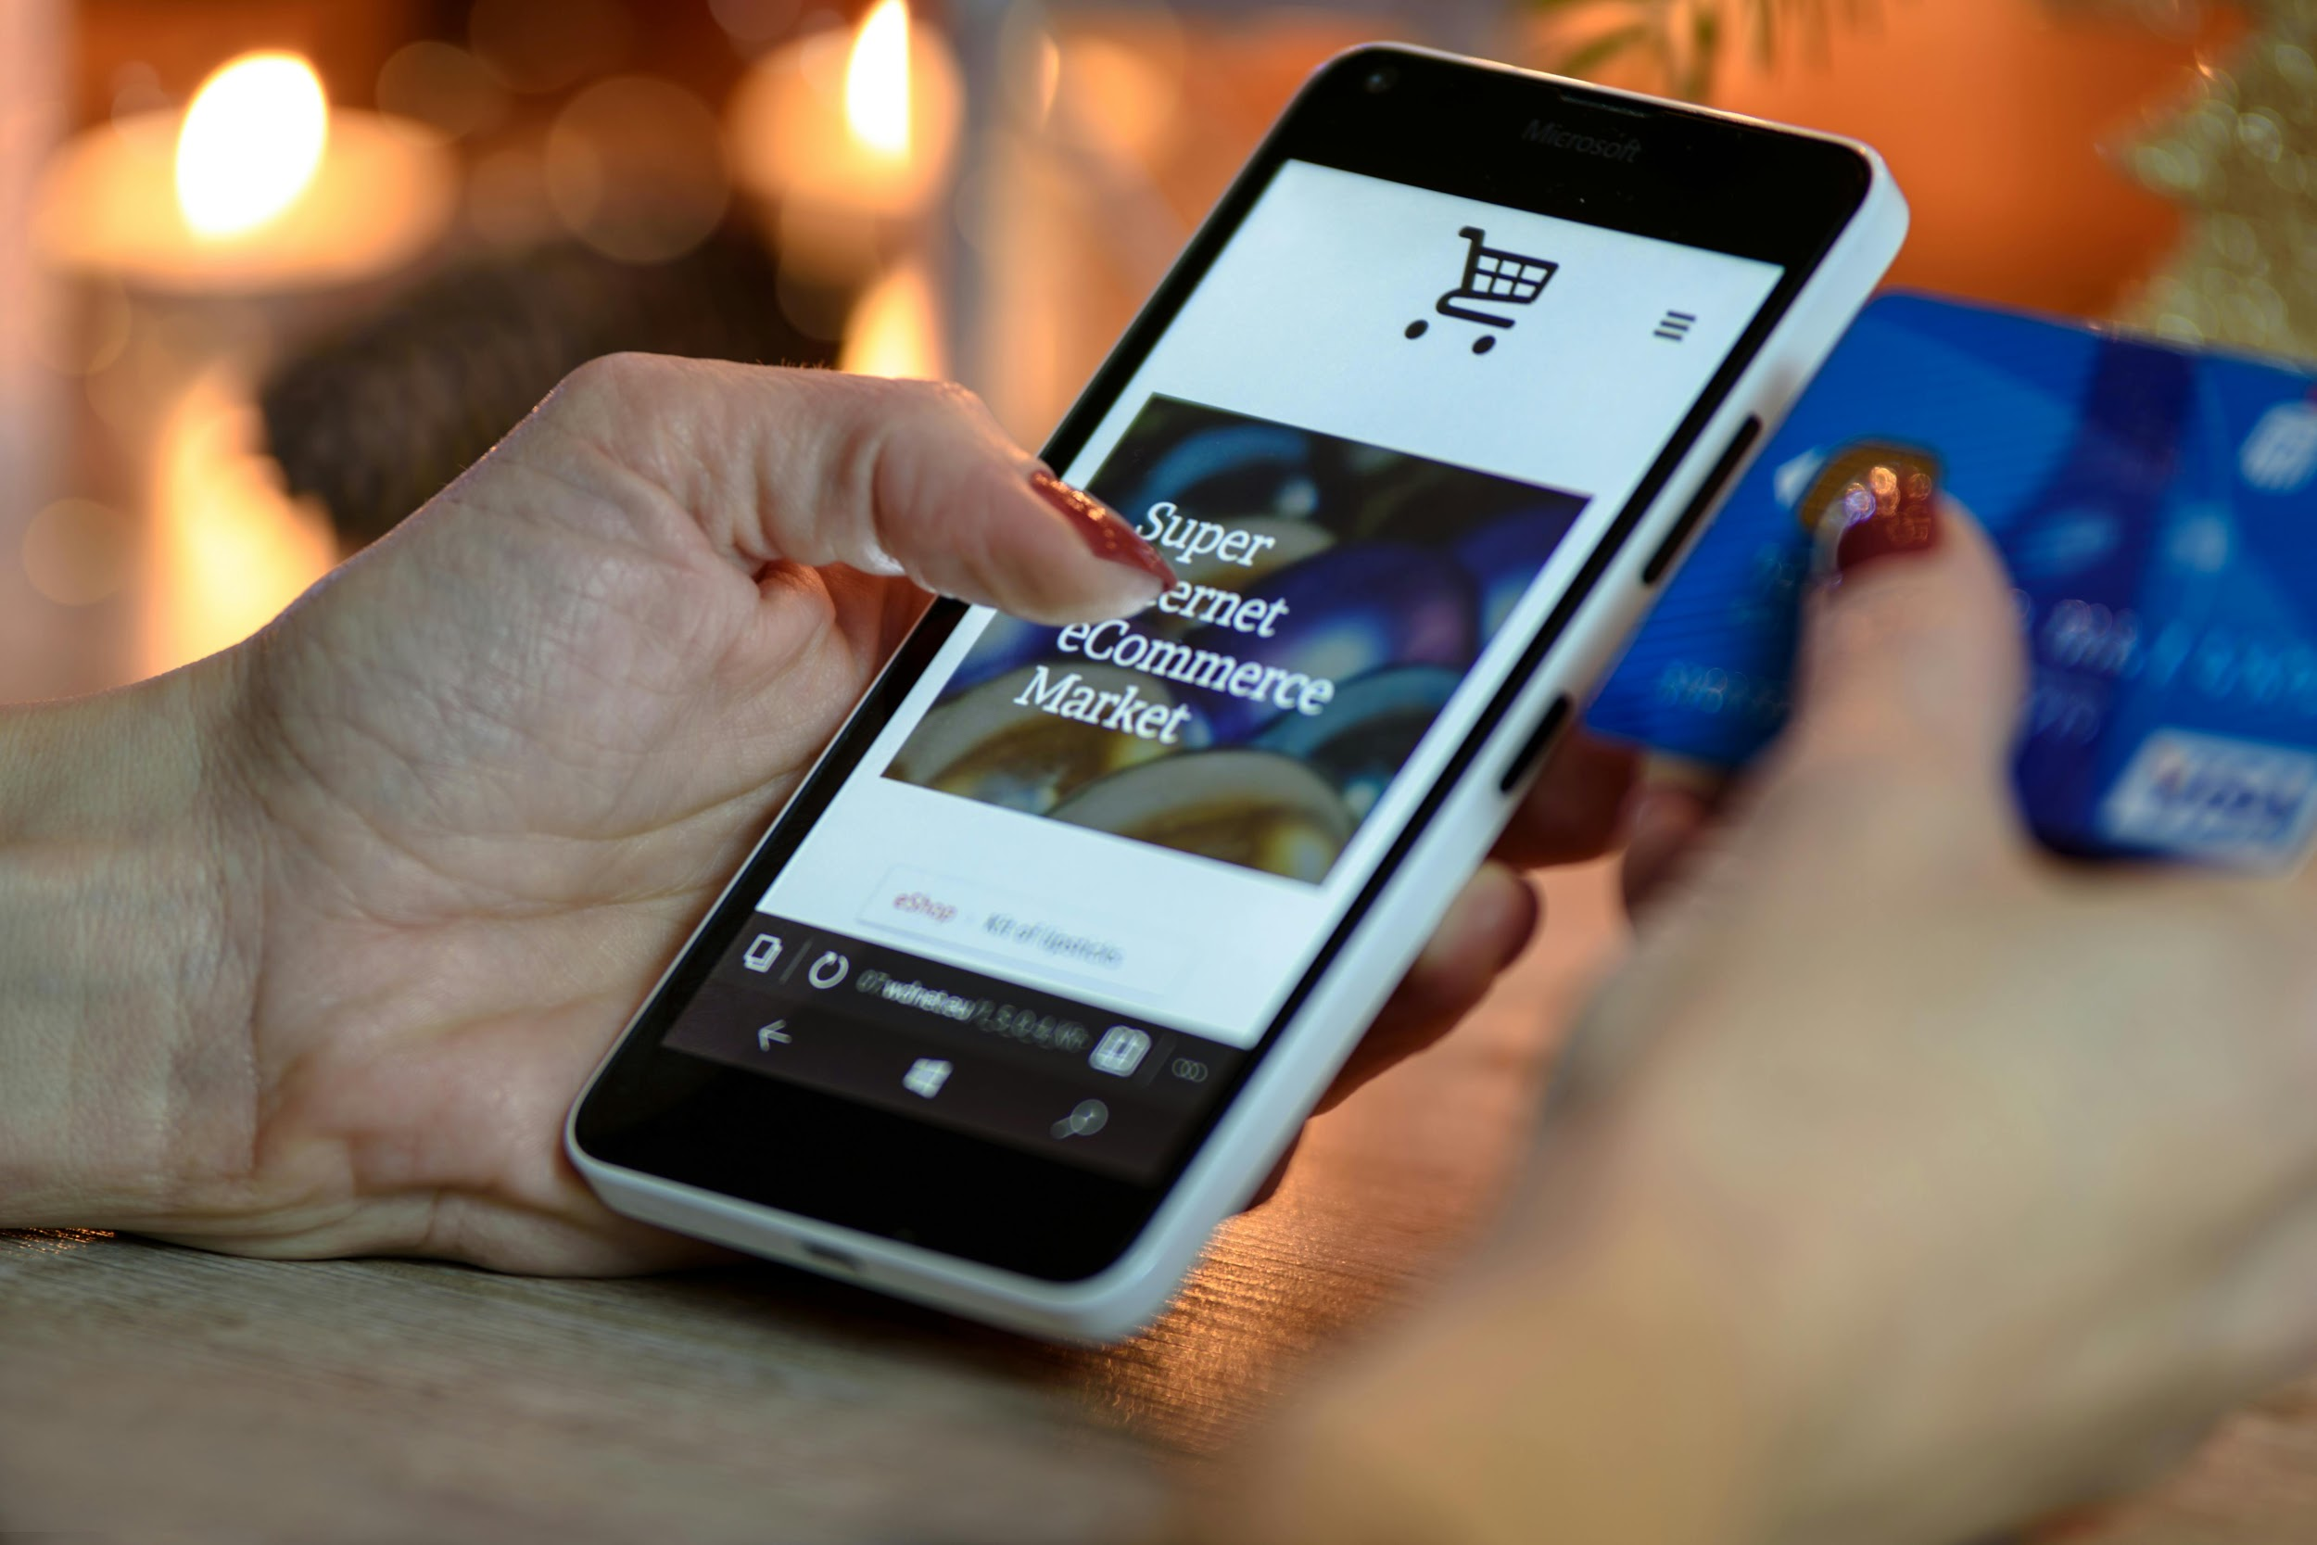

GlobalMart Tableau Dashboard
Case-Study

Slide 2

BUSINESS OVERVIEW
GlobalMart is an international retail company offering a wide range of products across multiple categories. The company prides itself on delivering quality products and excellent customer service. To continue its growth trajectory, GlobalMart aims to leverage data-driven insights to optimize its operations and enhance customer satisfaction.
Objectives
GlobalMart seeks to develop a comprehensive dashboard to track key performance indicators (KPIs) and analyze sales and profit data. This dashboard will provide actionable insights to drive strategic decisions and improve overall business performance.

Slide 3
DASHBOARD REQUIREMENTS
Sales and Profit Growth KPI: To monitor the company's overall financial health and growth over time.
Profit and Sales Trend: Purpose: To visualize trends in sales and profits over specific periods, identifying patterns and seasonal fluctuations.
Profit by Location (Country and Region): To analyze geographic performance, highlighting profitable regions and identifying areas for improvement.
Sales and Profits for Each Product Sub-Category: To evaluate the performance of different product segments, helping to optimize inventory and marketing strategies.

Slide 4
DATA DICTIONARY
Row ID- Unique id of the row
Order ID- Customer Unique Id
Order Date- Date of order of product from the store
Ship Date- Date the product was shipped
Ship Mode- Shipping mode of product purchased by customer
Customer ID- Each customer unique id
Customer Name- Name of customer that order a product
Segment- Customer Segment
Country- Customer residence Country
City - Customer residence City
State- Customer residence State
Postal Code- Customer postal code
Region- Region of the Country where the Customer Reside
Product ID- Unique Product Identify
Category- Product Category in the store
Sub-Category- Product Subcategory in the Store
Product Name - Name of each product in the store
Sales- Sales of the product
Quantity- Quantity of product sold
Discount- Discount giving to customer
Profit- Profit/Loss incurred
PALETTE
Dark Blue: #194466
Gold: #FCB815
background: #E7EAEF

Slide 5
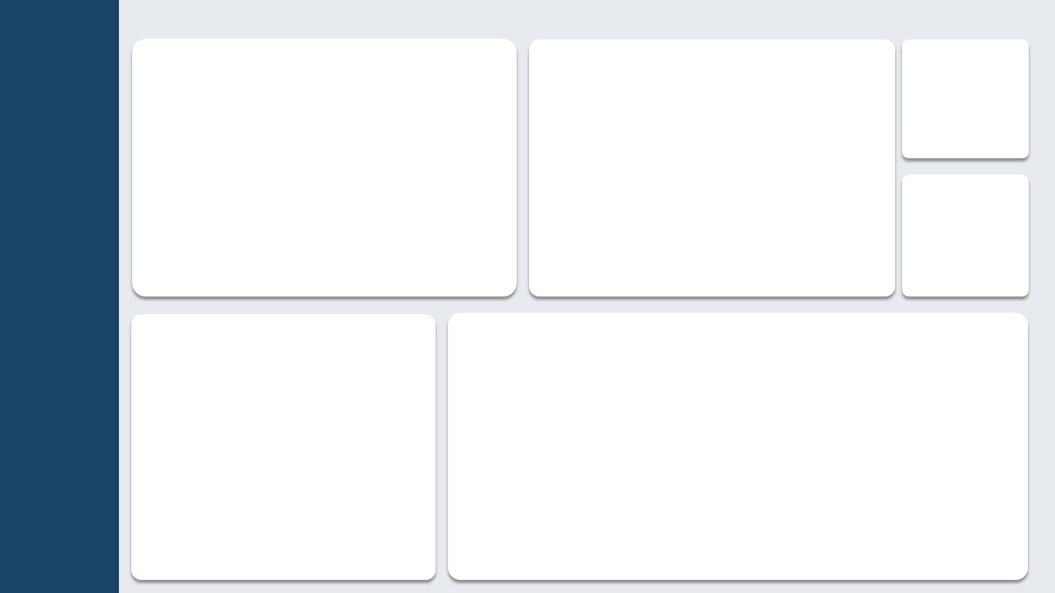

Slide 6
